Slide 1
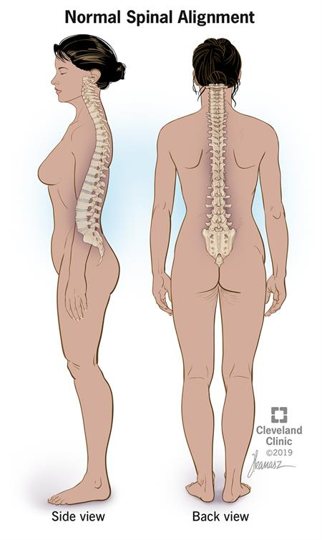
HUMAN POSTURE
Dr. Vivek B. Sathe
Senior Assistant Professor
School of Physical Education
DAVV, Indore

Slide 2
POSTURE
Posture is the position in which you hold your body while standing, sitting or lying down
Good posture involves training your body to stand, walk, sit and lie so as to place the least strain on muscles and ligaments while you are moving or performing weight-bearing activities

Slide 3
POSTURE
There are many concepts of human posture and many interpretation
For an orthopedic surgeon posture means soundness of skeletal framework and muscular system
For an artist posture means a tools for expressing mood and character
For Physical Education expert posture means an instrument of Mechanical Efficiency

Slide 4
POSTURE
POSTURE
Good Posture
Bad / Poor Posture

Slide 5
Good Posture
Good posture no longer means merely the ability to assume an erect standing position when it is desired but to handle the body easily, gracefully and efficiently under all circumstances
Good posture helps you in the following ways - Keeps bones and joints in the correct position (alignment) so that muscles are being used properly. - Helps cut down on the wear and tear of joint surfaces (such as the knee) to help prevent the onset of arthritis.

Slide 6
- Decreases the strain on the ligaments in the spine. - Prevents the spine from becoming fixed in abnormal positions. - Prevents fatigue because muscles are being used more efficiently, which allows the body to use less energy. - Prevents backache and muscular pain.
Good Posture

Slide 8
Bad / Poor Posture
Poor posture is the posture that results from certain muscles tightening up or shortening while others lengthen and become weak, which often occurs as a result of one's daily activities.
It may lead to pain, injury, or other health problems
There are different factors which can have an impact on posture, including occupational activities and biomechanical factors such as force and repetition
Risk factors for poor posture also include psychosocial factors such as job stress and strain
Poor posture can lead to postural deformities such as
Lordosis, Kyphosis, Scoliosis and many more

Slide 9
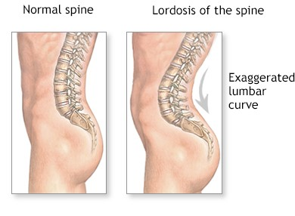
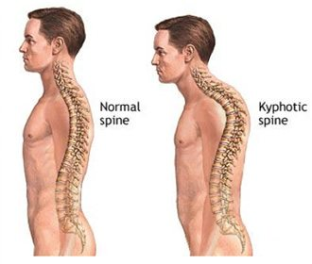
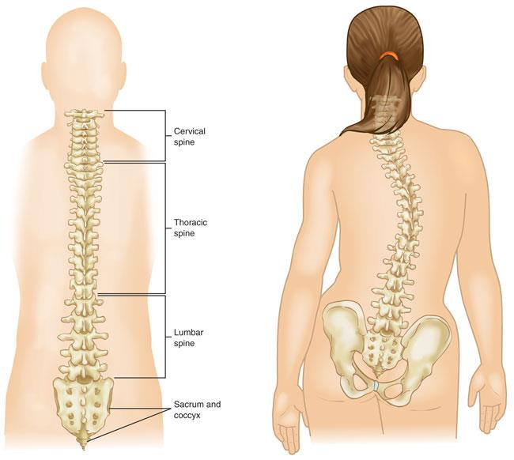
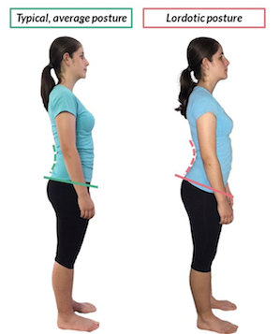
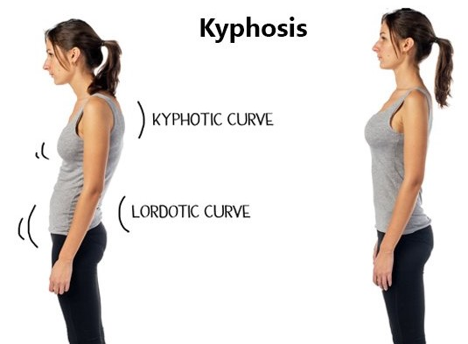
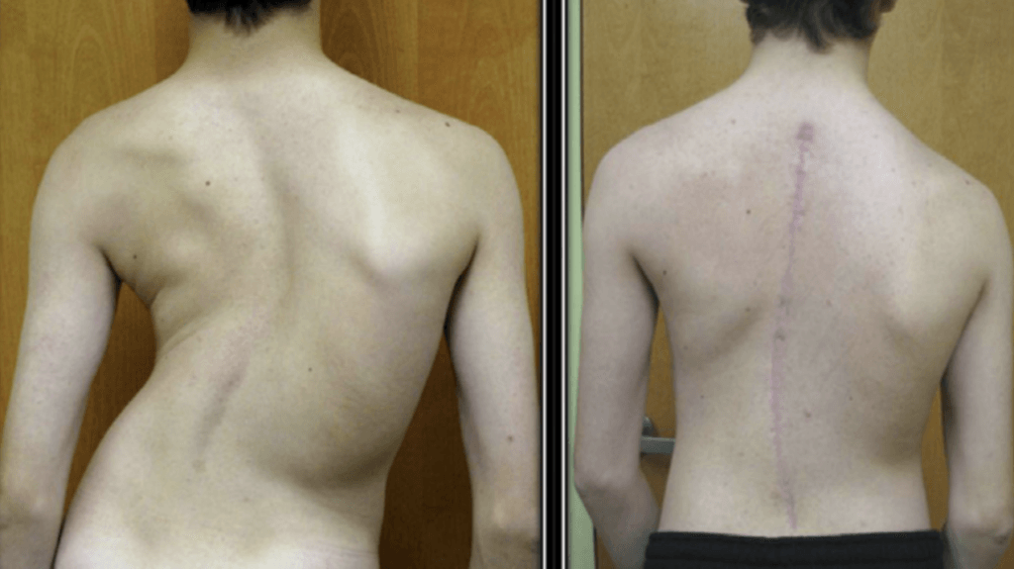
Lordosis
Kyphosis
Scoliosis

Slide 10
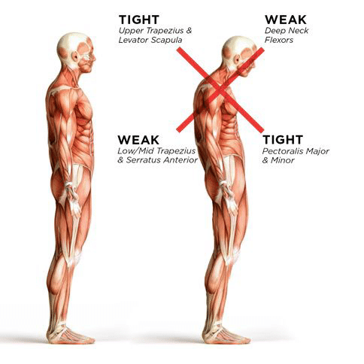
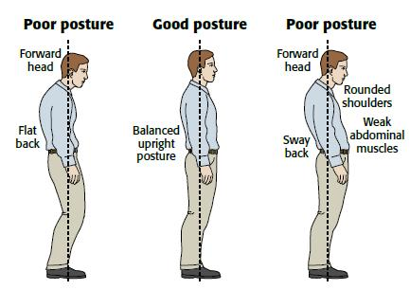
Impact of Poor Posture on Health
Headaches
Joints pain
Back pain
Hip, knee and foot pain
Fatigue and breathing problems
Sedentary lifestyle
Joint stiffness
Decreased fitness
Muscle weakness
Muscle imbalance

Slide 11
Some Causes of Bad / Poor Posture
Improper Diet | Lake of Proper Exercise
Diseases or Injuries | Unsuitable Furniture
Congenital | Improper way of carrying weight
Due to Accidents | Obesity
Fatigue | Occupation
Lake of Rest and Sleep | Mental Condition
Lake of Awareness / Knowledge | Improper Neuro muscular Coordination
Surgery | Habit
Heredity | Life Style

Slide 12
Bad and Good Posture

Slide 13
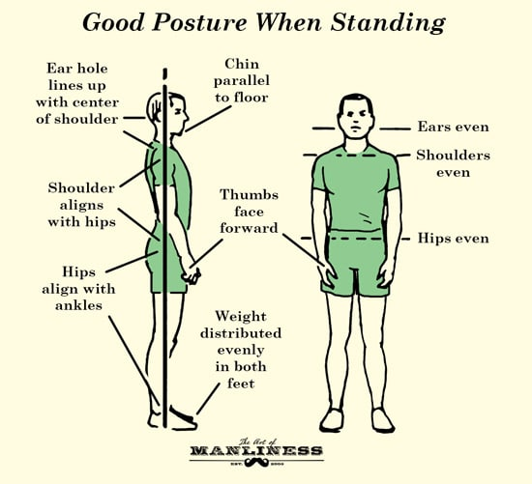
Best Posture for Everyday Practices
STANDING POSTURE
Equal weight throughout the left and the right side of the body
Keep your shoulders back and aligned

Slide 14
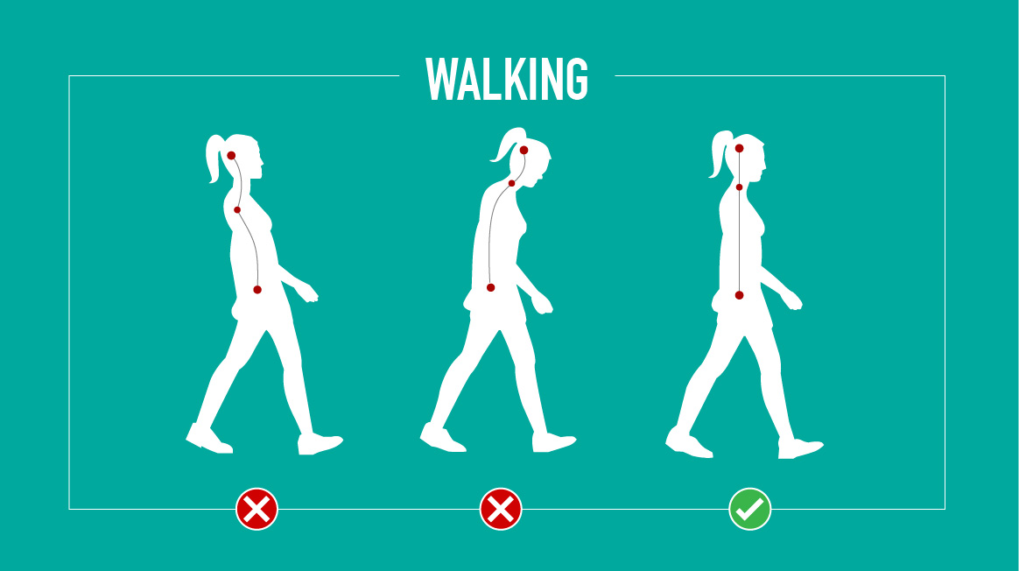
Best Posture for Everyday Practices
WALKING POSTURE
Keep the chin parallel to the ground
Make sure the heel is the first part to hit the ground
Keep the stomach and bottom in line with the rest of the body
Body should be symmetrical with the left and right mirroring each other

Slide 15
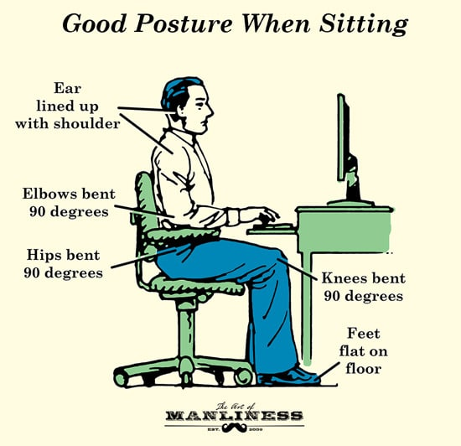
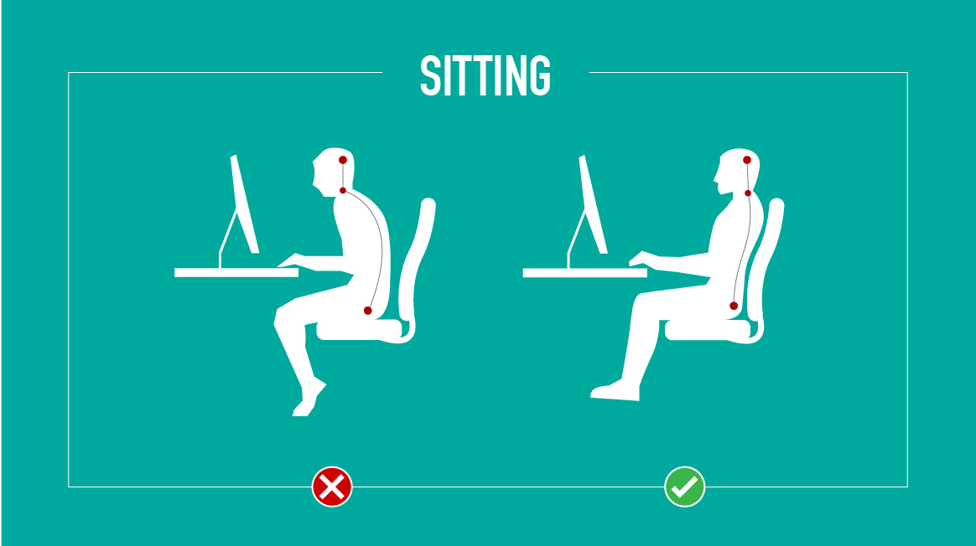
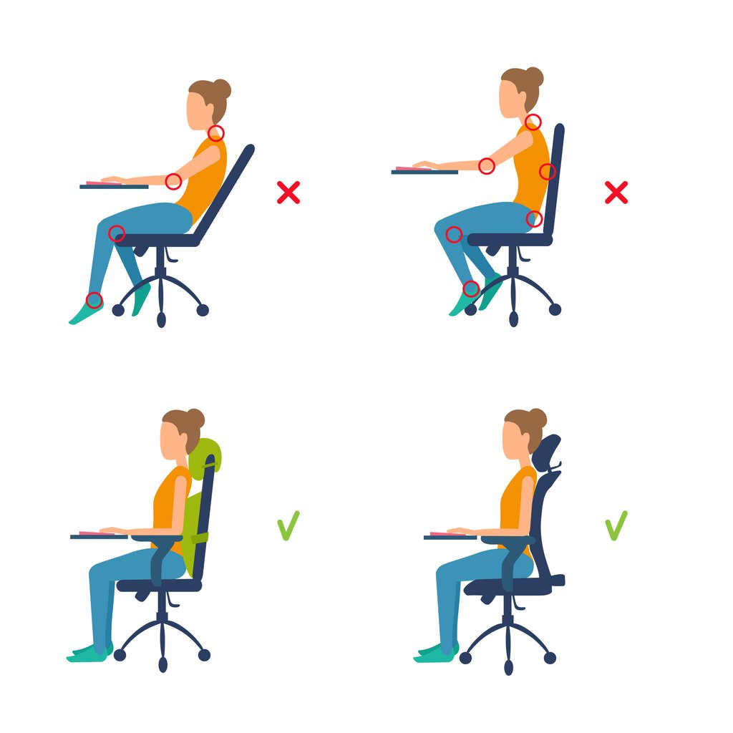
Best Posture for Everyday Practices
SITTING POSTURE
Keep the head straight and not tilted up or down
Should be close enough to the object that the elbows have a 90 to 120 degree bend
Chest should be situated straight above the hips

Slide 16
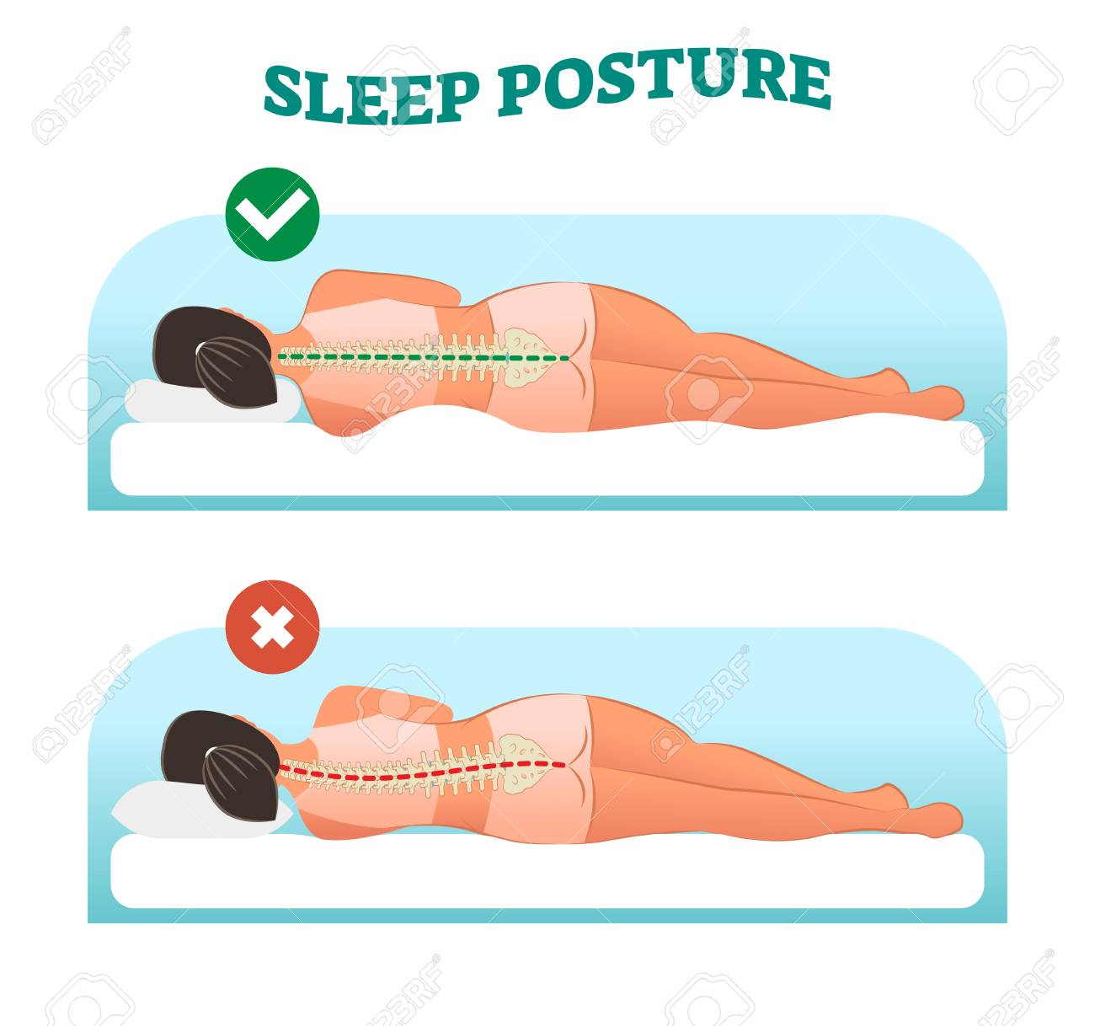
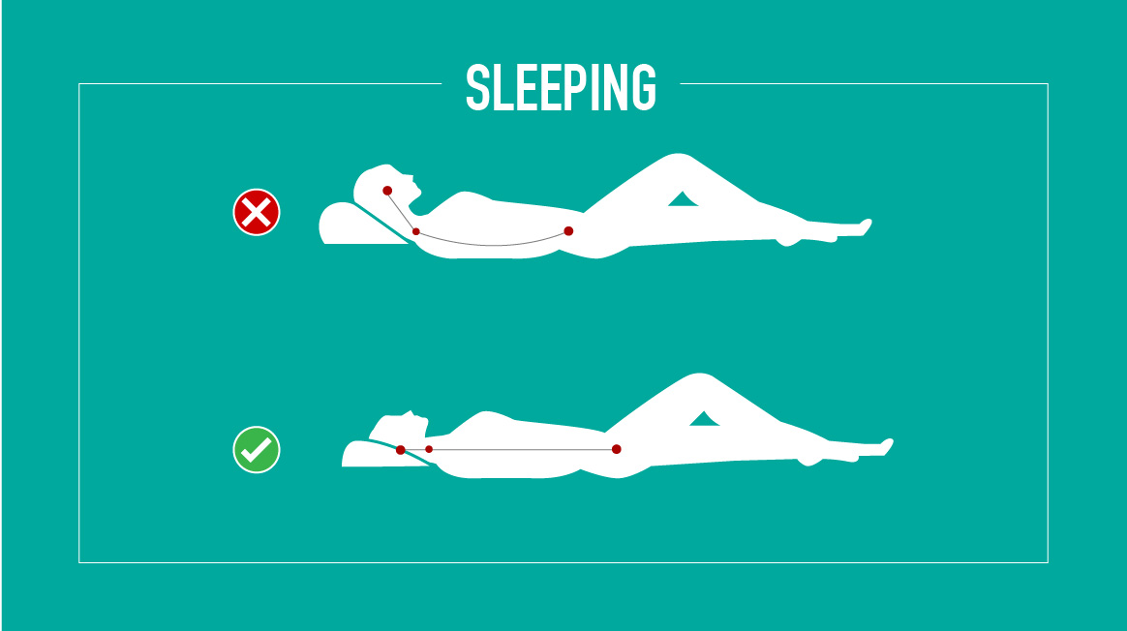
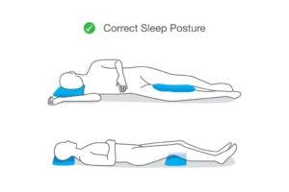
Best Posture for Everyday Practices
SLEEPING POSTURE
Sleeping position depends on personal preference but an ideal mattress is recommended
Don’t sleep with a stack of pillows as it will push your neck into a hard bend that is unnatural
Sleeping with a pillow between the legs can maintain optical alignment of the hips

Slide 17
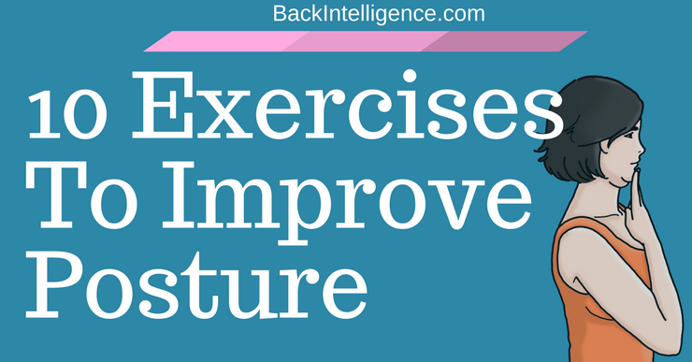

Slide 18
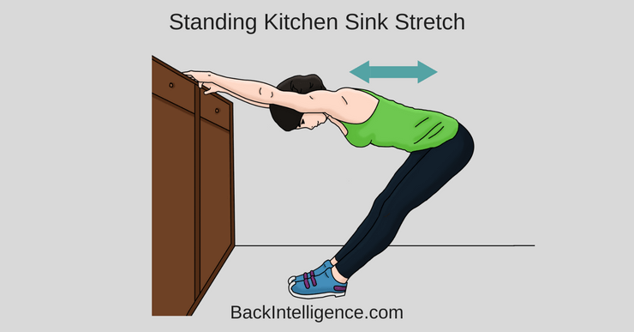
Decompression Using Standing Kitchen

Slide 19
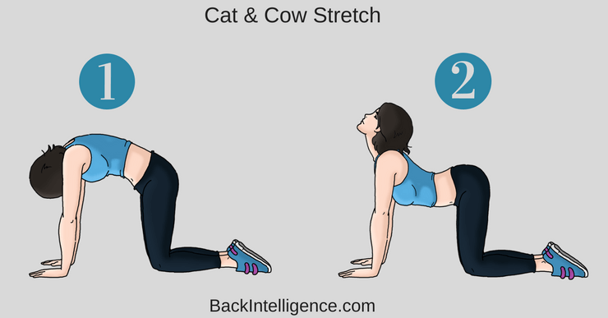
Cat & Cow (Use low range of motion)

Slide 20
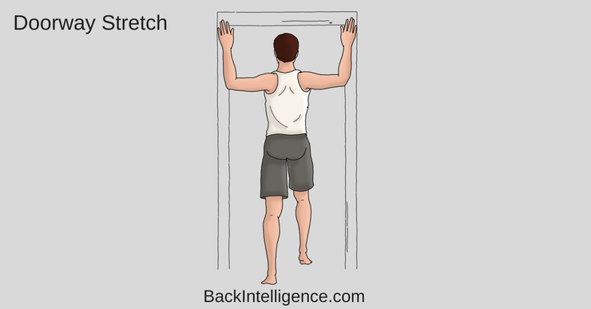
Doorway Stretch

Slide 21
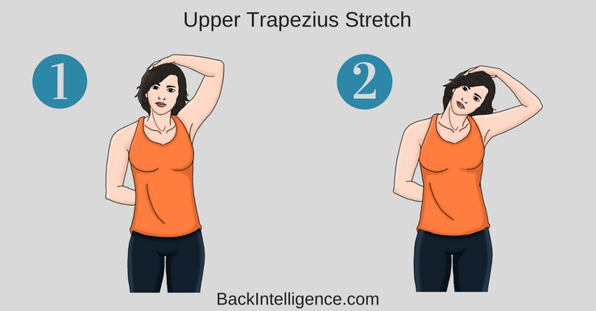
Upper Trapezius Stretch

Slide 22
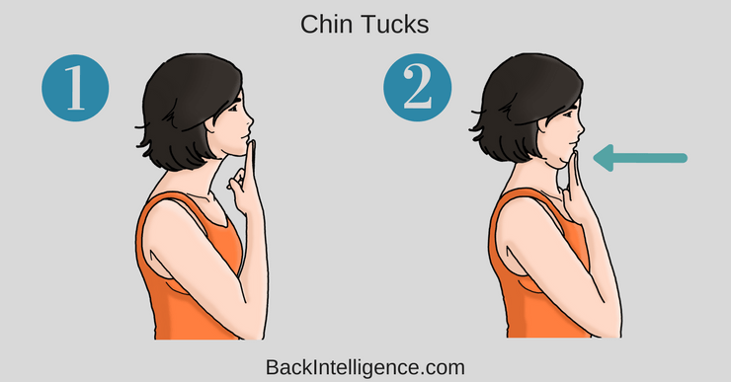
Neck Retraction (Chin tucks)

Slide 23
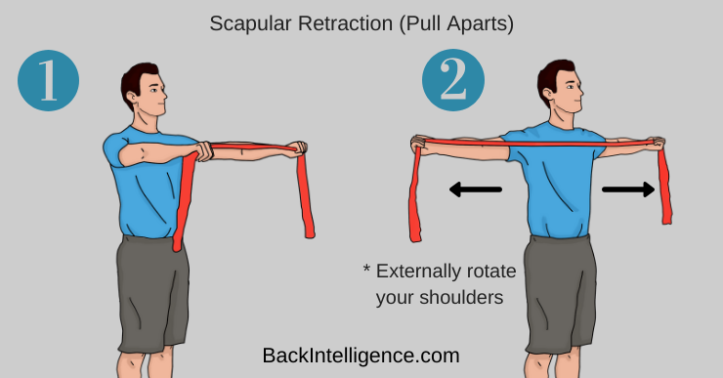
Standing Pull Apart (Using Resistance Bands)

Slide 24
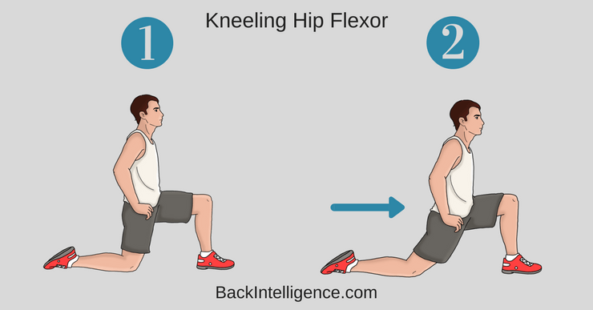
Kneeling Hip Flexor Stretch

Slide 25
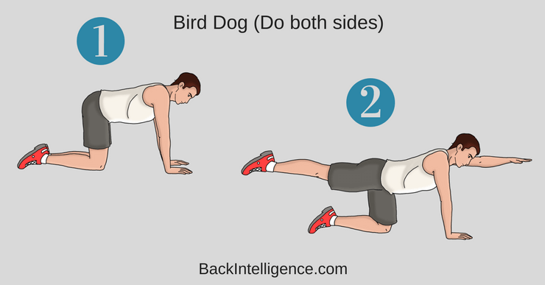
Bird Dog

Slide 26
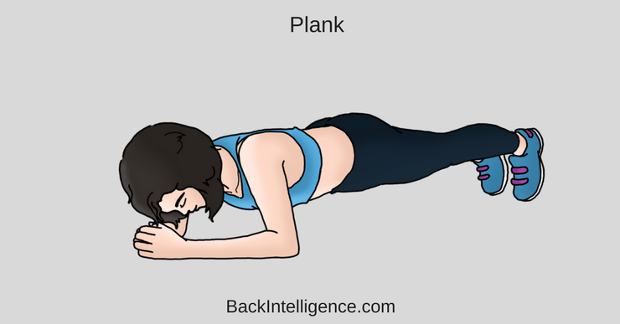
Plank

Slide 27
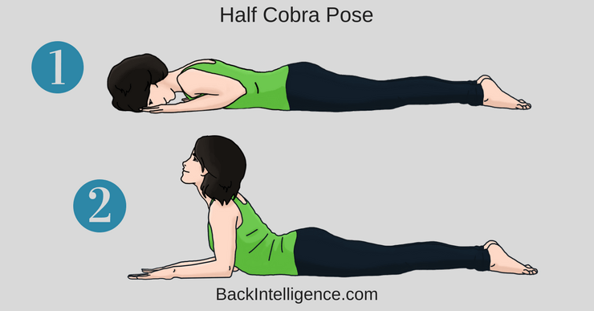
Half Cobra Pose

Slide 28
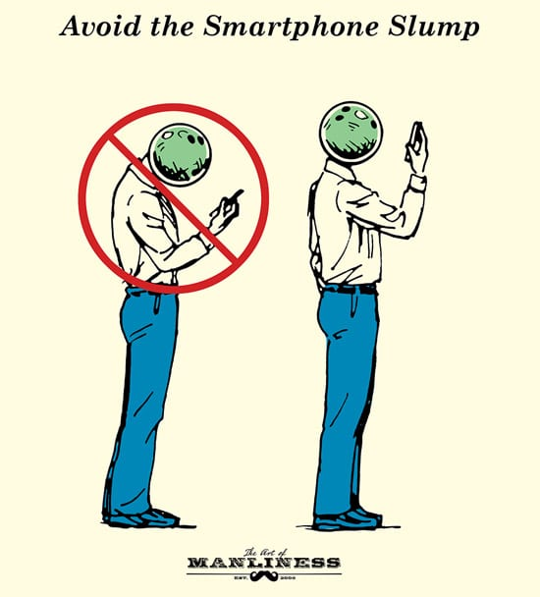
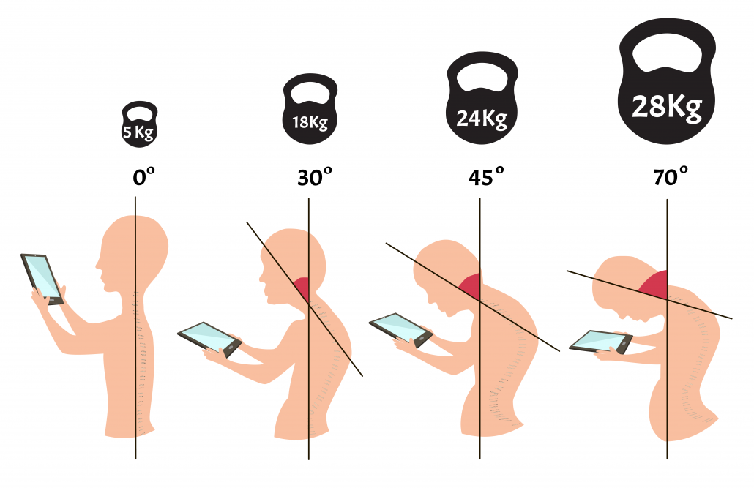
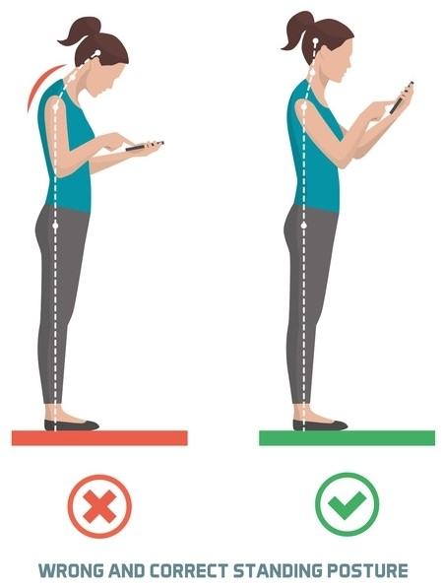
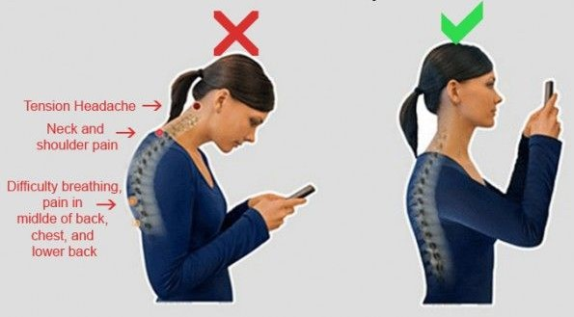
Please Mind Your Posture

Slide 29
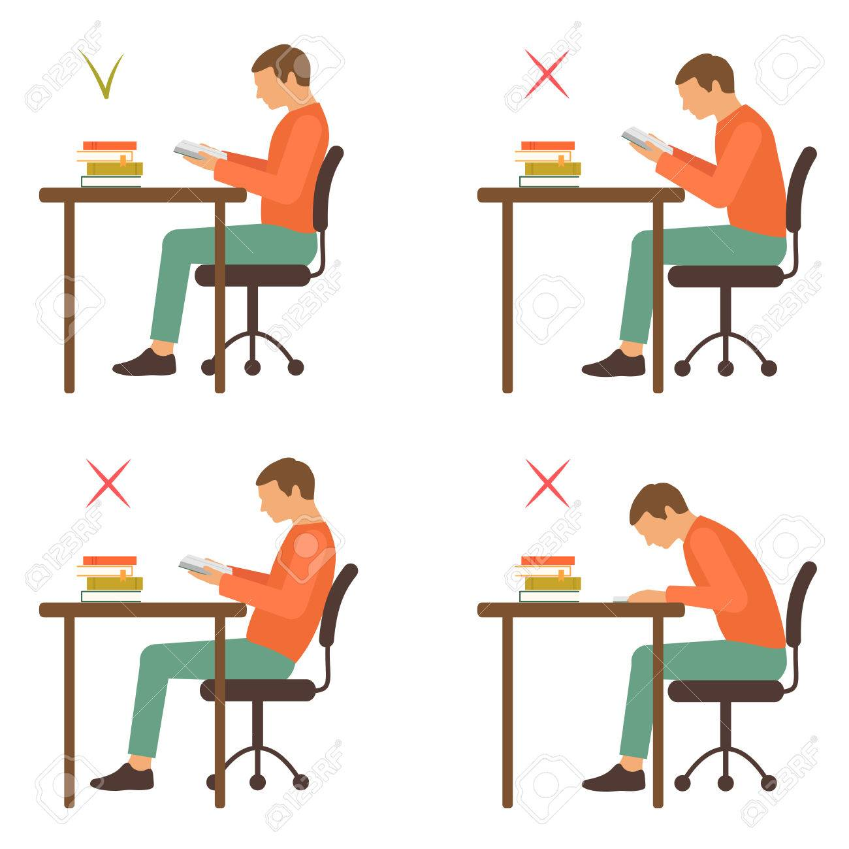
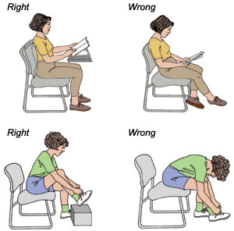
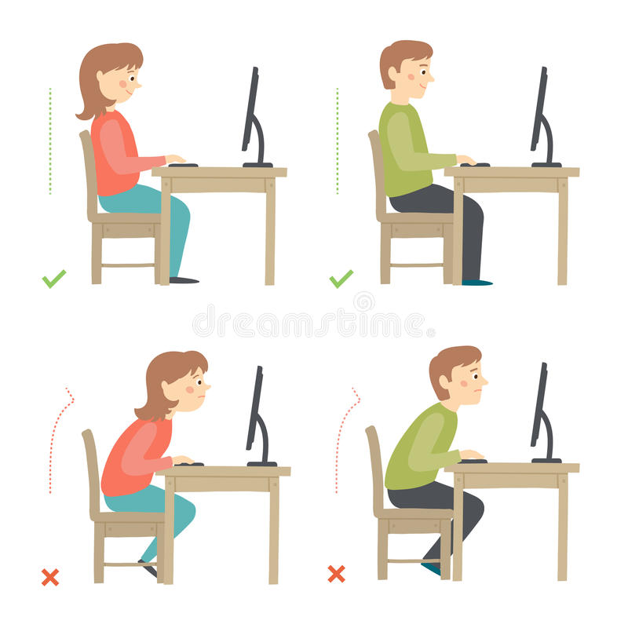
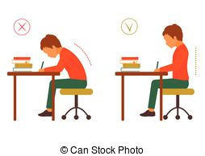
Please Mind Your Posture

Slide 30
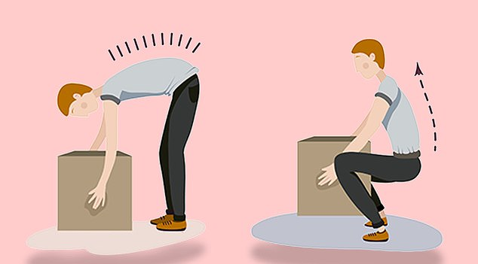
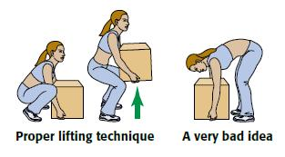
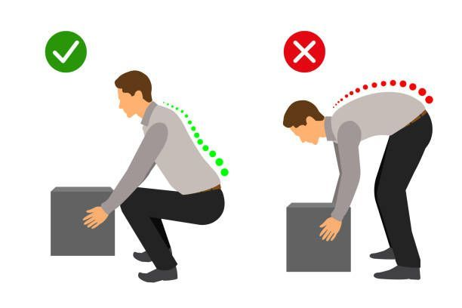
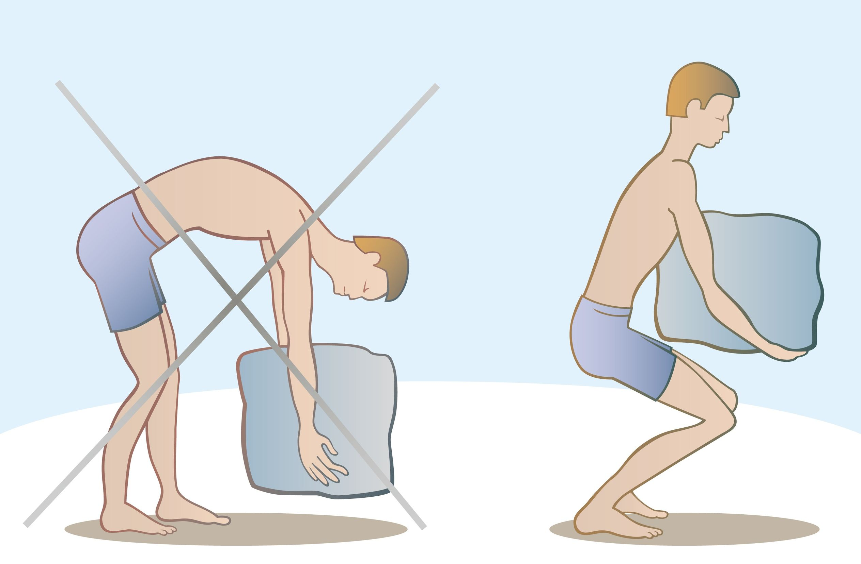
Please Mind Your Posture

